Slide 1
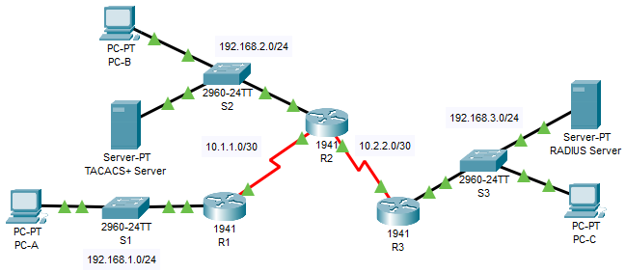
Configure Server-based Authentication with TACACS+ and RADIUS

Slide 2
Configure Server-based Authentication with TACACS+ and RADIUS
The network topology shows routers R1, R2 and R3. Currently, all administrative security is based on knowledge of the enable secret password. Your task is to configure and test local and server-based AAA solutions.
You will configure router R2 to support server-based authentication using the TACACS+ protocol. The TACACS+ server has been pre-configured with the following:
Client: R2 using the keyword tacacspa55
User account: Admin2 and password admin2pa55
Finally, you will configure router R3 to support server-based authentication using the RADIUS protocol. The RADIUS server has been pre-configured with the following:
Client: R3 using the keyword radiuspa55
User account: Admin3 and password admin3pa55
The routers have also been pre-configured with the following:
Enable secret password: ciscoenpa55
OSPF routing protocol with MD5 authentication using password: MD5pa55
Note: The console and vty lines have not been pre-configured.
Założenia:

Slide 3
Configure Server-based Authentication with TACACS+ and RADIUS rozwiązanie R2: conf t username Admin2 secret admin2pa55 tacacs-server host 192.168.2.2 tacacs-server key tacacspa55 aaa new-model aaa authentication login default group tacacs+ local line console 0 login authentication default

Slide 4
Configure Server-based Authentication with TACACS+ and RADIUS rozwiązanie R3: conf t username Admin3 secret admin3pa55 radius-server host 192.168.3.2 radius-server key radiuspa55 aaa new-model aaa authentication login default group radius local line console 0 login authentication default

